Slide 1
CS 3700 Networks and Distributed Systems
A Brief History of the Internet
(Hint: Al Gore is not involved)
Revised 9/7/16

Slide 2
What is a Communications Network?
A communications network is a network of links and nodes arranged so that messages may be passed from one part of the network to another
What are nodes and links?
People and roads
Telephones and switches
Computers and routers
What is a message?
Information
Networks are key for:
Speed
Distance

Slide 3
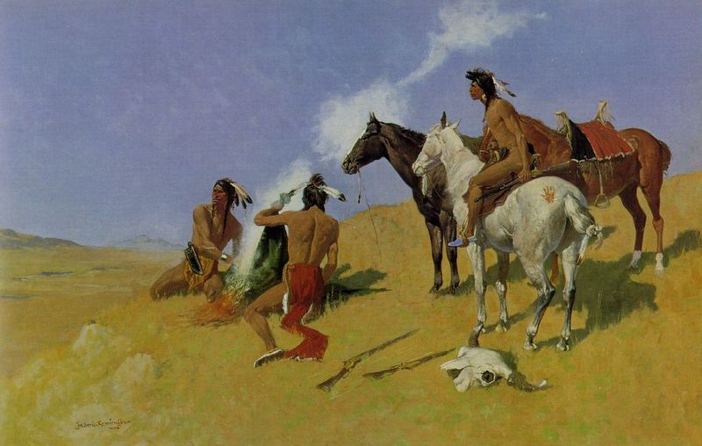
Networks are Fundamental
Smoke Signals!

Slide 4
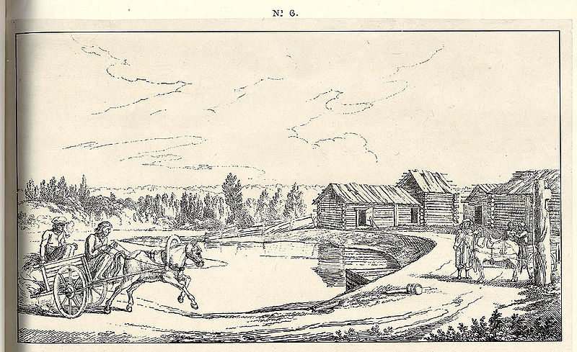
Networks are Old
2400 BC: courier networks in Egypt
550 BC: postal service invented in Persia
Problems:
Speed
Reliability
Security

Slide 5
Towards Electric Communication
1837: Telegraph invented by Samuel Morse
Distance: 10 miles
Speed: 10 words per minute
In use until 1985!
Key challenge: how to encode information?
Originally used unary encoding
A • B •• C ••• D •••• E •••••
Next generation: binary encoding
A •– B –••• C –•–• D –•• E •
Higher compression = faster speeds

Slide 6
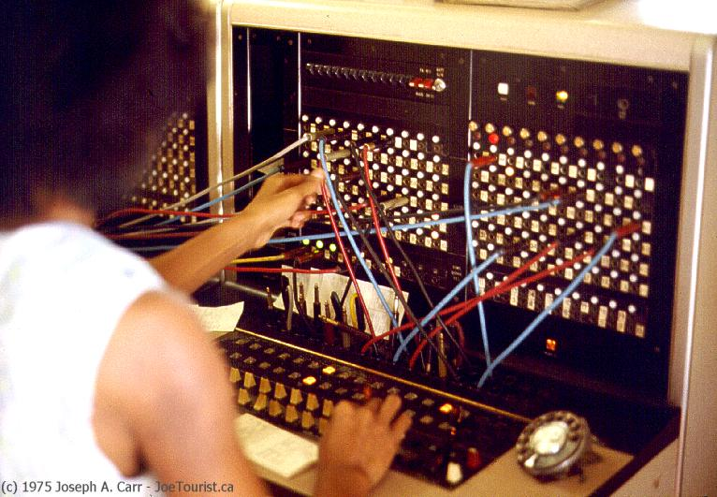


Telephony
1876 – Alexander Graham Bell invents the telephone
Key challenge: how to scale the network?
Originally, all phones were directly connected
O(n²) complexity; n*(n–1)/2
1878: Switching
1937: Trunk lines + multiplexing
Advantages
Easy to use
Switching mitigates complexity
Makes cable management tractable
Problems
Manual switching
1918: cross country call took 15 minutes to set up

Slide 7
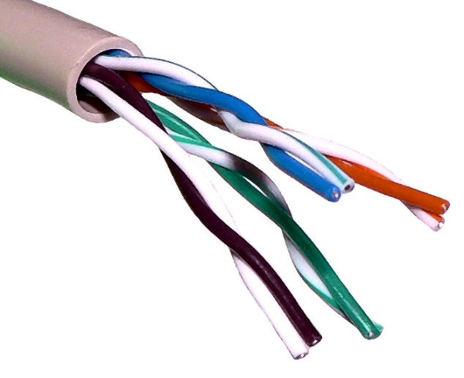
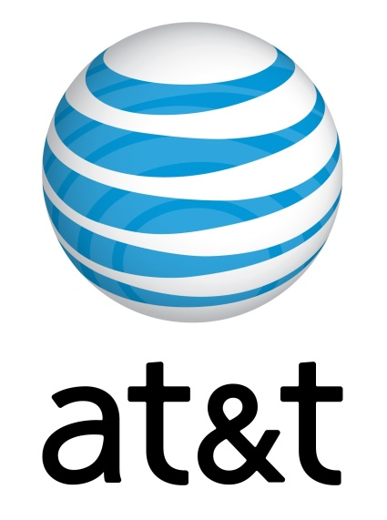
Growth of the Telephone Network
1881: Twisted pair for local loops
1885: AT&T formed
1892: Automatic telephone switches
1903: 3 million telephones in the US
1915: First transcontinental cable
1927: First transatlantic cable
1937: first round-the-world call
1946: National numbering plan

Slide 8
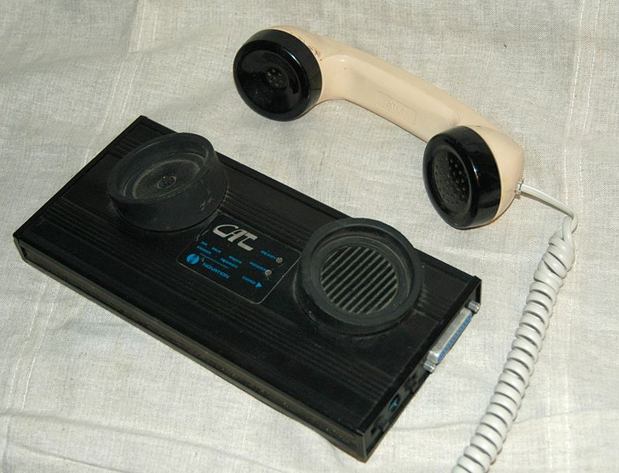
From Humans to Computers
1958: First use of a modem
Machine to machine communication
Analog vs. digital signals
Many different computer networks
Local vs. global
LAN, WAN
Private vs. public
Internet2, NIPRNet
General purpose vs. special purpose
E.g. credit cards, banks, defense
Technology
Satellite, Copper, Fiber
Circuit switched, packet switched

Slide 9
Crazy Idea: Packet Switching?
Telephone networks are circuit switched
Each call reserves resources end-to-end
Provides excellent quality of service
Problems
Resource intense (what if the circuit is idle?)
Complex network components (per circuit state, security)
Packet switching
No connection state, network is store-and-forward
Minimal network assumptions
Statistical multiplexing gives high overall utilization

Slide 10
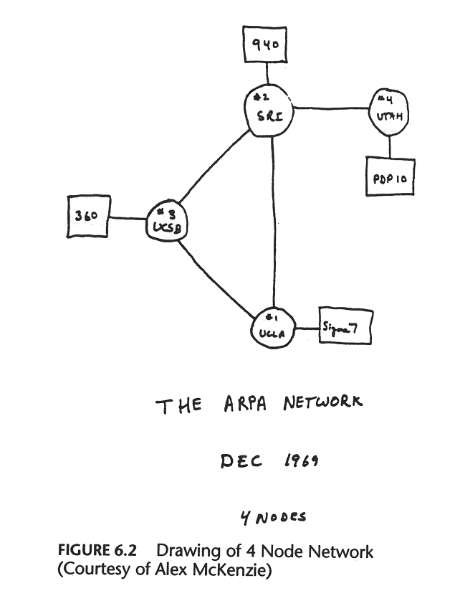

Slide 11
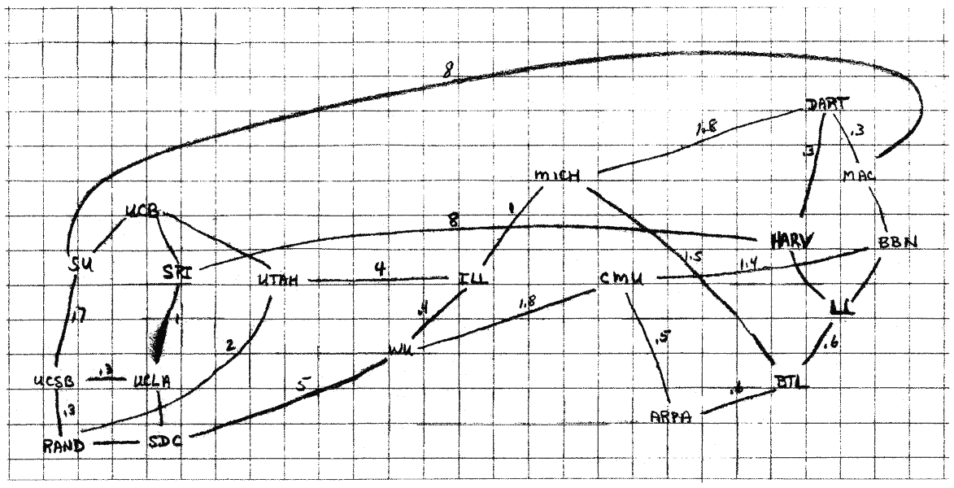
The 1960s

Slide 12
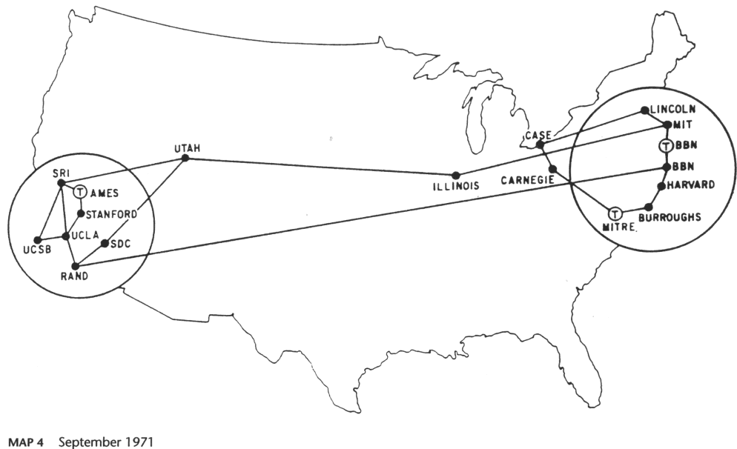
1971

Slide 13
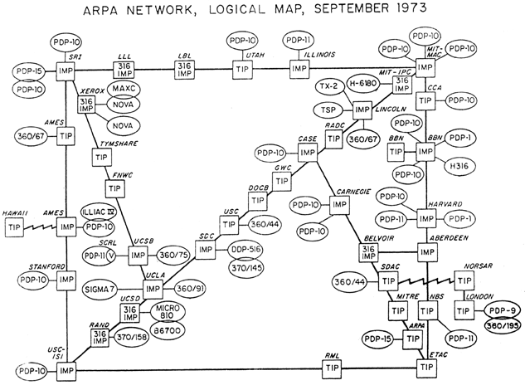
1973

Slide 14
History of the Internet
1961: Leonard Kleinrock @ MIT: packet-switched network
1962: Joseph Licklider’s vision of Galactic Network
1965: Larry Roberts connects computers over phone line
1967: Larry Roberts publishes vision of ARPANET
1969: BBN installs first InterfaceMsgProcessor at UCLA
1970: Network Control Protocol (NCP)
1972: Public demonstration of ARPANET
1972: Bob Kahn @ DARPA advocates Open Architecture
1972: Vint Cerf @ Stanford writes TCP

Slide 15

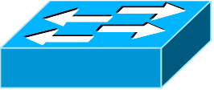
Growing Pains
Problem: early networks used incompatible protocols

Slide 16
Kahn’s Ground Rules
Each network is independent, cannot be forced to change
Best-effort communication (i.e. no guarantees)
Routers connect networks
No global control
Principals behind the development of IP
Led to the Internet as we know it
Internet is still structured as independent networks

Slide 17

The Birth of Routing
Trivia
Kahn believed that there would only be ~20 networks.
He was way off.
Why?

Slide 18
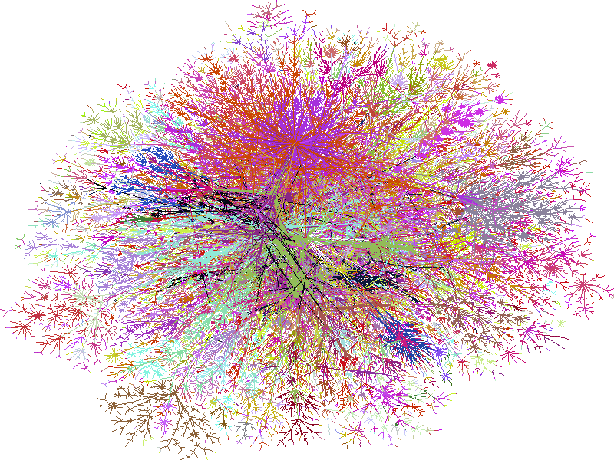
2000

Slide 19
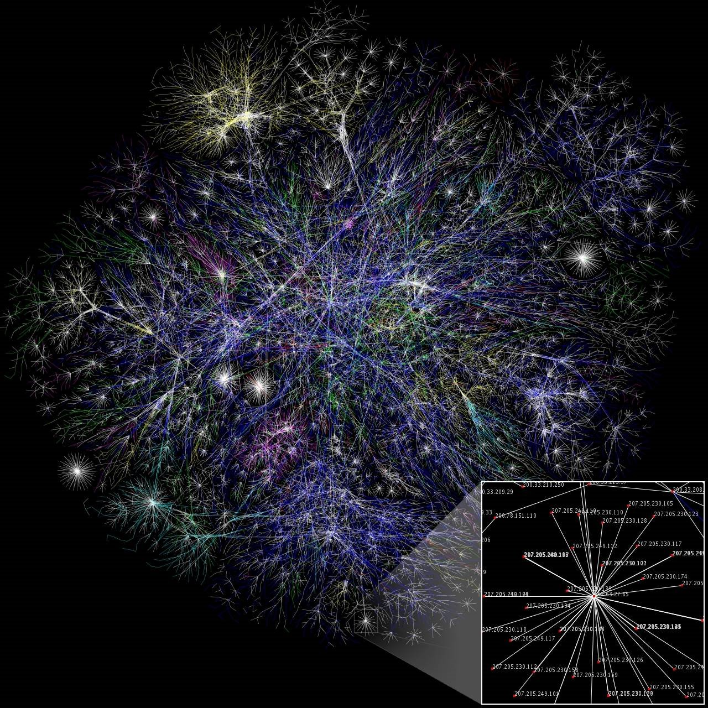
2006
19

Slide 20

2009
20

Slide 21
More Internet History
1974: Cerf and Kahn paper on TCP (IP kept separate)
1980: TCP/IP adopted as defense standard
1983: ARPANET and MILNET split; global NCP to TCP/IP flag day
198x: Internet melts down due to congestion
1986: Van Jacobson saves the Internet (BSD TCP)
1987: NSFNET merges with other networks
1988: Deering and Cheriton propose multicast
199x: QoS rises and falls, ATM rises and falls
1994: NSF backbone dismantled, private backbone
1999-present: The Internet boom and bust… and boom
2007: Release of the iPhone, rise of the Mobile Internet
2015: FCC classifies broadband under Title II, enforces Network Neutrality

Slide 22
Internet Applications Over Time
1972: Email
1973: Telnet – remote access to computing
1982: DNS – “phonebook” of the Internet
1985: FTP – remote file access
1989: NFS – remote file systems
1991: The World Wide Web (WWW) goes public
1995: SSH – secure remote shell access
1995-1997: Instant messaging (ICQ, AIM)
1998: Google
1999: Napster, birth of P2P
2001: BitTorrent
2004: Facebook
2005: YouTube
2007: iTunes App Store
What is next?
Invented by Shawn Fanning at NEU

Slide 23
Takeaways
Communication is fundamental to human nature
Key concepts have existed for a long time
Speed/bandwidth
Latency
Switching
Packets vs. circuits
The Internet has changed the world
Communication is now free ($) and free (freedom)
Shrunk the world
What made the Internet so successful? Stay tuned!
Encoding
Cable management
Multiplexing
Routing
Security
Privacy

